Slide 1
Stroll Safe
Locating your loved ones ❤
Alex Bruma | Alvin Tsang | Kevin Chung | Pegah Aryadoost | Steve Statia
Notes:
Intro slide to put up as we prepare for the presentation

Slide 2
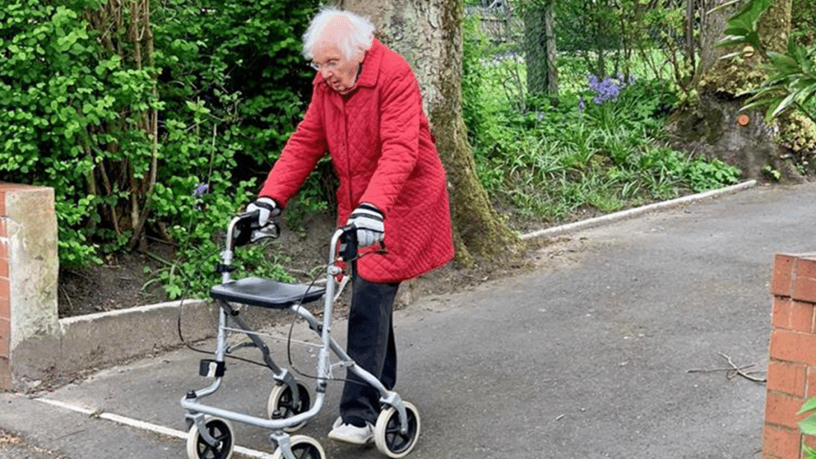
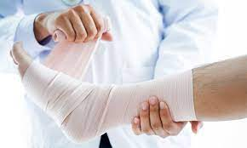
^{[1]}“Over the five year period, 130 missing person cases were reported…71% of the individuals being found. Of these, 60% were found well, 20% were found injured and 20% were found deceased.”
Figure 2: Elderly person walking
Source: Adapted from [3]
Figure 1: Injury
Source: Adapted from [2]
Notes:
ALVIN
While researching we found this quote that encapsulated why we are developing this app. This research article from the Australian Journal on Aging reported that “ Over the five-year period [2011 - 2015], 130 missing person cases were people with dementia. 62% missing persons travelled on foot and were last seen at home. Reports described 92 (71%) of the individuals being found. Of these, 60% were found well, 20% were found injured, and 20% were deceased.”
M. MacAndrew, L. Schnitker, N. Shepherd and E. Beattie, “People with dementia getting lost in Australia: Dementia related missing person reports in the media, ” Australian Journal on Aging, vol. 37 no. 3, September, 2018. [Online] Available:
https://onlinelibrary.wiley.com/doi/pdfdirect/10.1111/ajag.12542 [Accessed Jun.2, 2022]

Slide 3
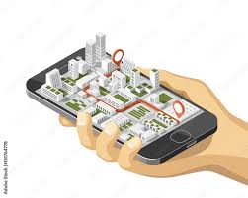
What is Stroll Safe?
PWD monitoring application
Promote autonomy for PWD
Up to date medical & personal information
Notes:
ALVIN
Stroll safe is a monitoring and information application for PWD and their caregivers
The application will promote autonomy for PWD while reducing the risks of unfavourable outcomes such as injury or death when going out for a stroll on their own
The application can also hold current personal information they would need access to every day as well as up-to-date medical information in case of an emergency.

Slide 4
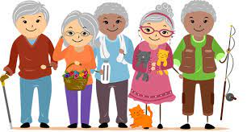
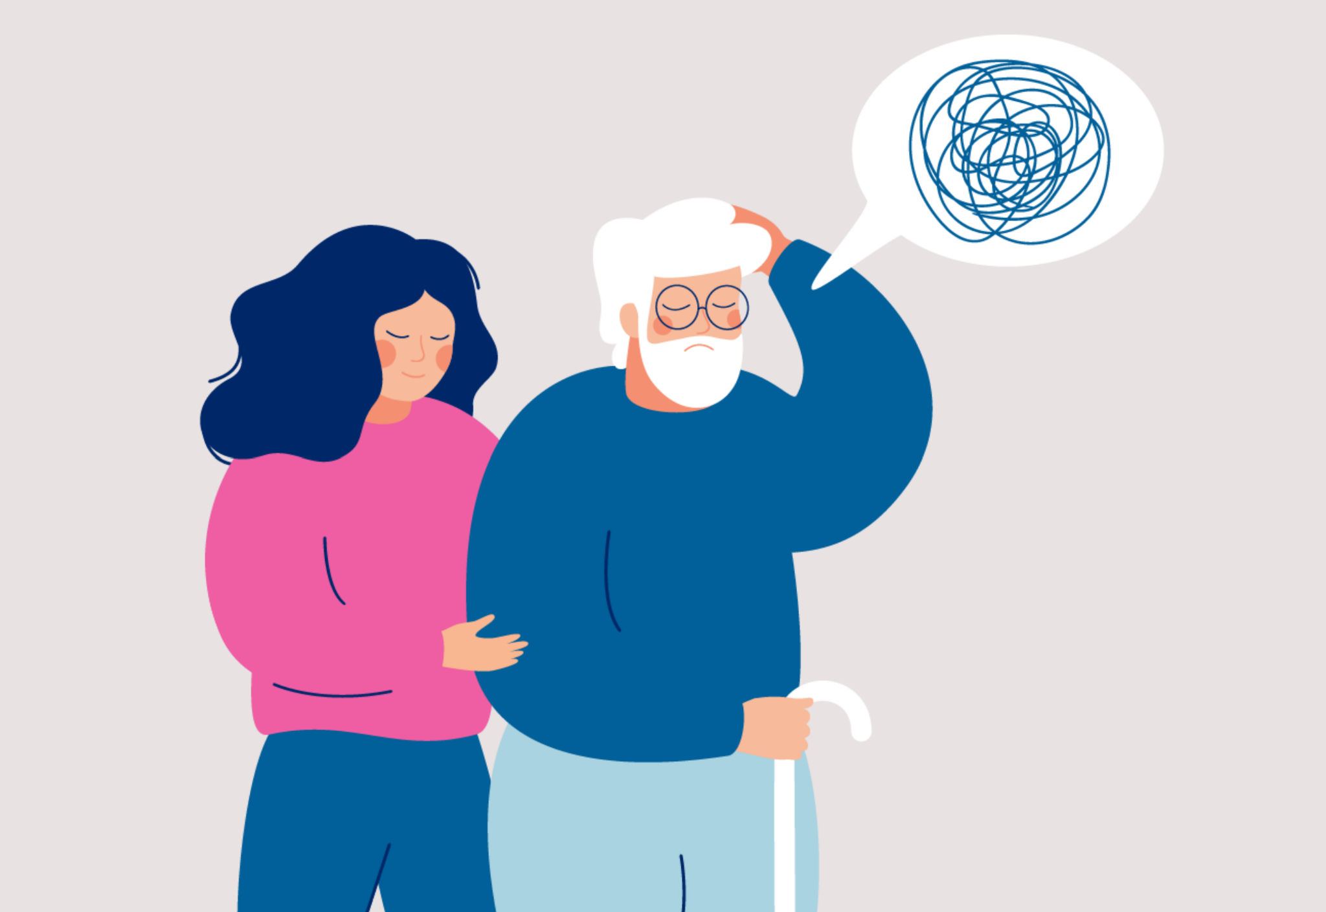
Target User group
Patients with Dementia
Caregiver and Family
Notes:
ALVIN:
Our app will target two groups of people, those with dementia and their caregivers and loved ones. Through research, we believe our application will be most effect for PWD in [4] early and middle stages (2-5) because PWDs still have the ability to be independent, but are often forgetful and unable to remember recent events such as how they go to their current location.
We hope that our application will ease the stress off of caregivers and family in case they can’t find their loved one.

Slide 5
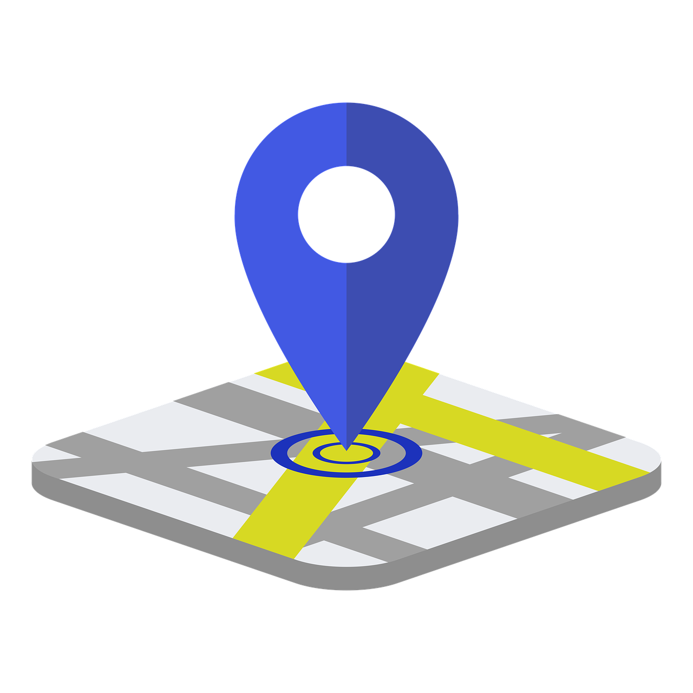
System Overview
Caregiver + PWD mode
Location tracking.
Emergency notification.
Low battery notification.
Customizable safe zones.
SOS feature.
Inactivity notifications.
Patient’s health information.

Slide 6

How will these help?
Location tracking can allow caregivers to not lose their PWD
Notifications allows caregivers to respond as fast as possible
Safe zones allow PWD to move around freely in a space without notifying caregiver
SOS feature allows for PWD to get emergency help
Patient health information allows caregivers easier access to medical info

Slide 7



Project Workflow
Version control
CI / CD
Project Management
Java
MySQL
Notes:
Notion for project management; managing, assigning, and keeping track of tasks
Android Studio as it has android emulators, use for developing and testing.
Gitlab for version control / CI/CD as its required
We will be using Java to develop our application

Slide 8
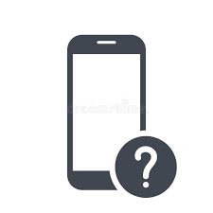
Why a mobile application?
[5] Almost everyone has access to a smartphone (83.72% of the world population)
We keep our mobile devices with us all day everyday
Mobile devices have extremely useful core functionalities
Ease of use and accessibility
Notes:
Now I’m going to talk about why our application works so well on the mobile platform.
Since a good portion of the population have mobile devices, it makes it very easy for a caretaker, family member, and person with dementia to just download the application and get it set up.
We are so used to having our cell phone with us throughout the day, everyday it makes it a great candidate for an alert system for ensuring our loved ones are safe and where they are supposed to be.
Mobile devices are capable of calling emergency services, sending text messages, alert notifications and using location services to send and receive locations. With these core functionalities being present on almost all smartphones it allows our application to leverage them to make powerful features.
Mobile devices allow for customizations of font sizes, colourblind modes, text to speech, and much more. These will greatly aid in making the application much better for elderly users which make up the majority of people with dementia.
Refrences - https://www.bankmycell.com/blog/how-many-phones-are-in-the-world#:~:text=According%20to%20Statista%2C%20the%20current,world's%20population%20owns%20a%20smartphone.

Slide 9

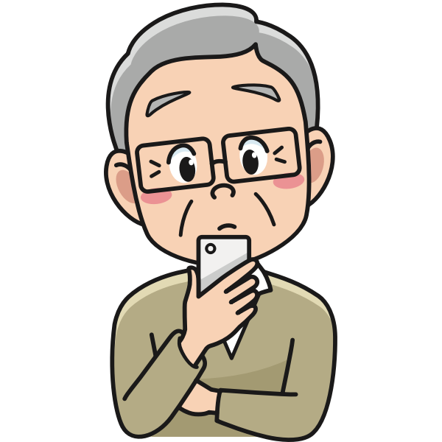
Challenges
Elderly people and technology don’t always go hand in hand
People with dementia may forget, or misplace their mobile device
Notes:
Given the current generation of people with dementia did not necessarily all grow up with technology so closely integrated with their lives, a challenge arises on getting them to use it to its full potential. This may mean that they may forget to keep their phone with them, or misplace it frequently. This is why we plan to implement features such as idle notifications, so caregivers are aware if the phone is no longer with the the person with dementia. And battery notifications so that we can ensure that the smartphone battery is always at a good level.

Slide 10
References
[1] M. MacAndrew, L. Schnitker, N. Shepherd and E. Beattie, “People with dementia getting lost in Australia: Dementia related missing person reports in the media, ” Australian Journal on Aging, vol. 37 no. 3, September, 2018. [Online] Available: https://onlinelibrary.wiley.com/doi/pdfdirect/10.1111/ajag.12542 [Accessed Jun.2, 2022]
[2] T, Jin. “10 sports injuries with lifelong consequences”, Health Plus, April, 2017 [Online] Available: https://www.mountelizabeth.com.sg/healthplus/article/10-sports-injuries-with-lifelong-consequences [Accessed Jun.7, 2022]
[3] L. Rogan. “This 99-year-old lady from middleton has raised 15k walking 100 lengths for the NHS”, Secret Manchester, April 2020 [Online] Available: https://secretmanchester.com/win-page-nhs-walk/ [Accessed Jun.7, 2022]
[4] Mayo Clinic Staff, “Alzheimer’s stages: how the disease progresses”, Mayo Clinc, April 2021 [Online] Available: https://www.mayoclinic.org/diseases-conditions/alzheimers-disease/in-depth/alzheimers-stages/art-20048448 [Accessed Jun.7, 2022]
[5] A. Turner, “How many people have smartphones worldwide (Jun 2022),” BankMyCell, 01-Jun-2022. [Online]. Available: https://www.bankmycell.com/blog/how-many-phones-are-in-the-world#:~:text=According%20to%20Statista%2C%20the%20current,world's%20population%20owns%20a%20smartphone. [Accessed Jun.7, 2022]

Slide 11

Q&A
Notes:
Our functionality is very similar to AirTags as with air tags you can:
Set multiple “safe” locations where you WON'T receive a notification if the airtag is left there.
Be notified if you have left the airtag behind
Show the location of the airtag at all times
Remind you to change the battery when it is low
If found by someone else they can call/text/email you to let you know they have found it
Can only be used by the user that setup the airtag
The differences:
UI is not geared toward elderly / people with dementia
Location is an address and not a customizable radius
No emergency calling
Can't notify family members or caretakers of location
Can't notify family members or caretakers when it leave a certain area

